Slide 1
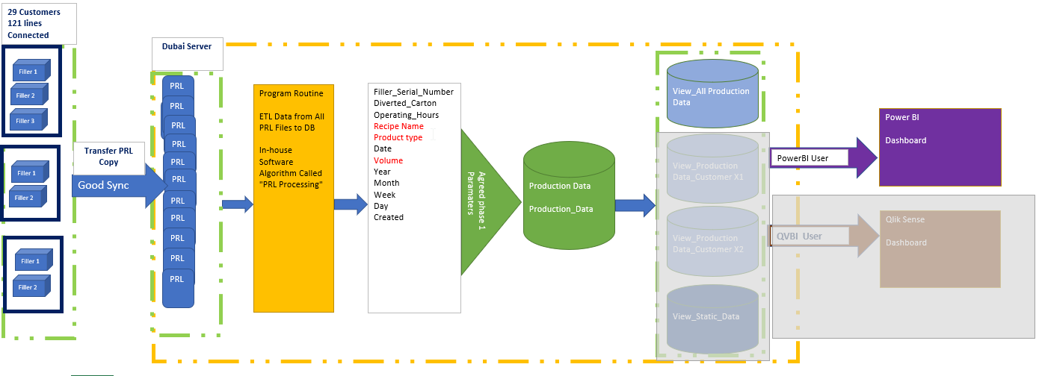
- PRL (log) file is generated in the Fillers every 24 hours (midnight)
- PRL (log) files can be synchronized to our server through a VPN router installed at customers’ sites
- Even Fillers w/o ECS or ConnectorBox can deliver PRL files to Dubai Server
2019 -- Connected 29 customers 121 lines
2021 – 27 still reflected in 90 lines
One Network kit costs ~2200 €
GSM Data 4G to transfer max 85 MB/day → 3GB/Month

Slide 2
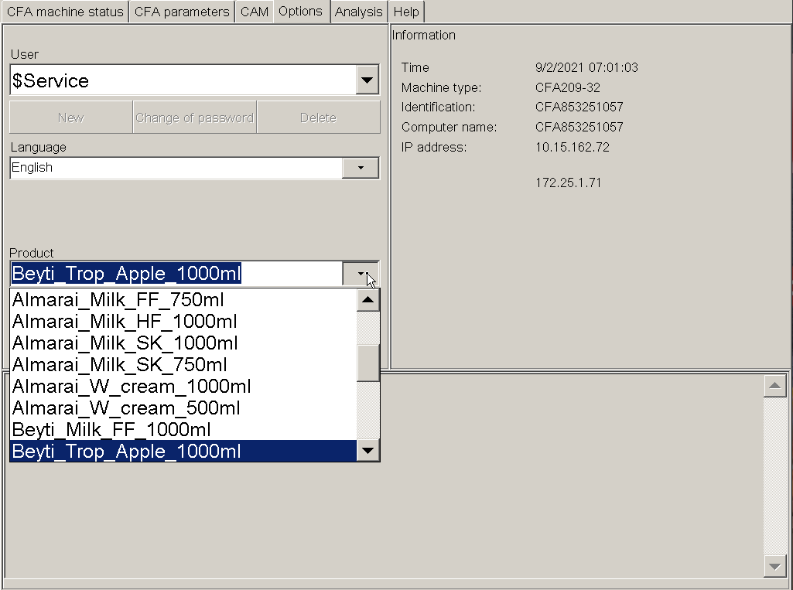
Select User Name
Select Recipe Name

Slide 3
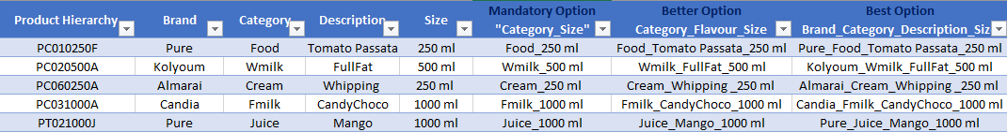
SOP Cycle: Standardize Recipe Naming
Process Procedure to improve data accuracy for SKUs
3- SIG Site Represent
Communicate the New Standard Recipe Name
1- Supply Chain Department
Provide updated list for all active product Hierarchy per customer
Deliverable
Create/Update and implement all available Product Recipe into HMI
Communicate and implement
Deliverable
Monthly update product Hierarchy List of each customer
Product Hierarchy List
Standardize Recipe Name
Recipe Name List
2- Marketing & Technical
Create Recipe table list with standard format
“BrandName_Category_Description_Size”
(ex: Classic_Wmilk_FF_1000ml)

